Slide 1








Budget
Line
By Safalta Shrestha

Slide 2
Table of content
Introduction
Budget line is based on
Slope of Budget Line
Swing and Shift in Budget Line
Conclusion

Slide 3
Introduction
The budget line is the locus of different combinations of two goods which a consumer can purchase by spending his/her given money income and market prices.
Budget line can be presented by a budget equation. Px*Qx + Py*Qy = M
where, Px=Price of X commodity Qx =Quantity of X commodity
Py=Price of Y commodity Qy =Quantity of Y commodity
M= Money income(Budget)

Slide 4
Budget Line is Based on
Consumer consumes two goods.
Consumer has to pay price for the goods.
A consumer has a limited income.

Slide 5
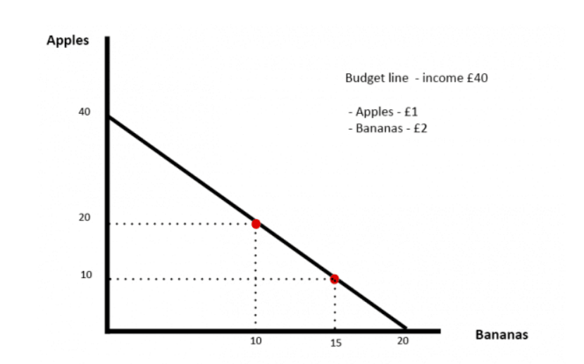
Example
If an apple costs £1 and a banana £2, the above budget line shows all the combinations of the goods which can be bought with £40. For example:
20 apples @ £1 and 10 bananas @£2
10 apples @£1 and 15 bananas @£2

Slide 6
Example
Assume that a consumer has a total budget of ₹40, with which he can buy various combinations of Good X and Good Y. The cost of one unit of Good X is ₹8 and the cost of one unit of Good Y is ₹4 respectively. Now, the potential set of combinations that can be purchased by the consumer are:

Slide 7
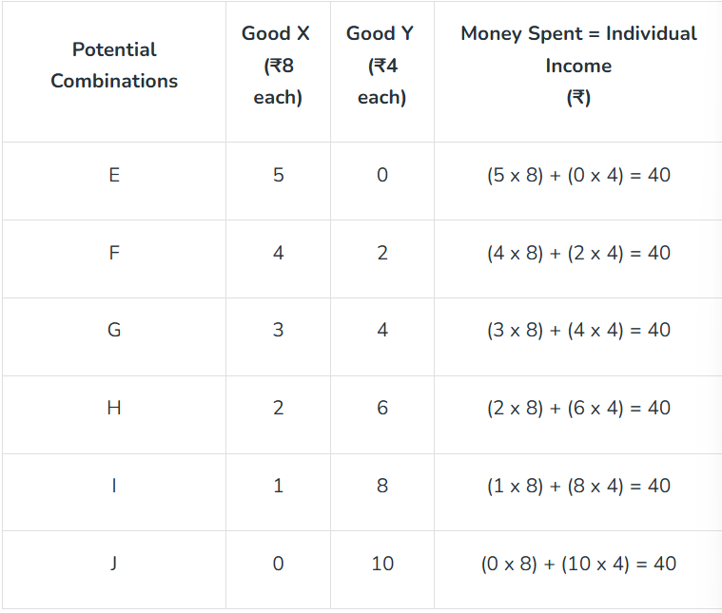

Slide 8
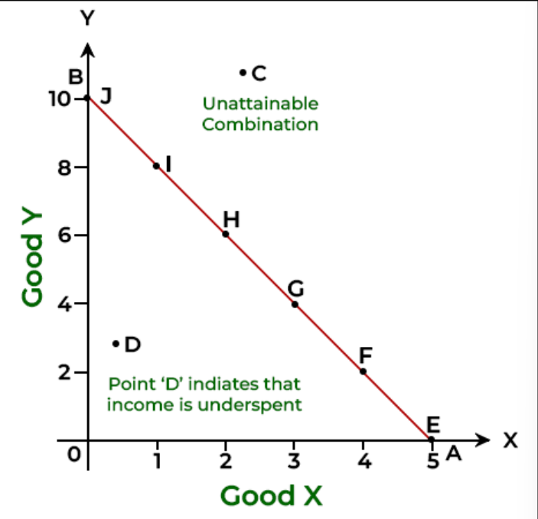

Slide 9
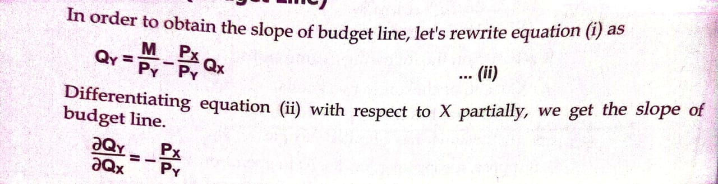
Slope of Budget LIne
The slope of the budget line shows the rate at which one good is sacrificed to get more of another good.

Slide 10
Swing in Budget Line
Swing in budget line is the process of change in budget line where one point is constant and another point moves up and down.
Other things remaining the same, if price of particular commodity increase budget line swing downward and if price of commodity decrease budget line swing upward

Slide 11



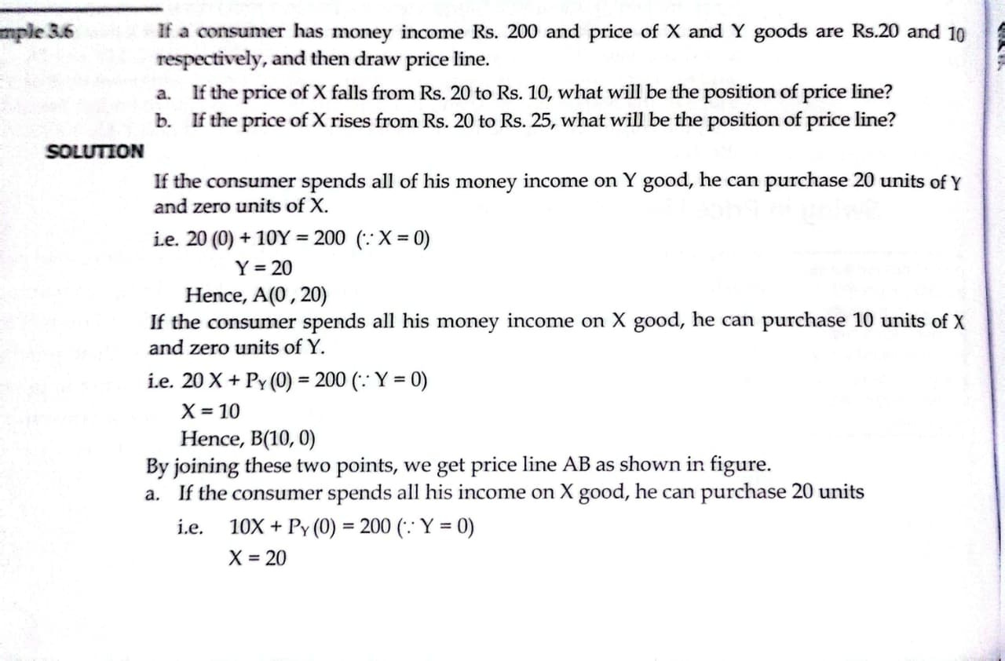

Example

Slide 12
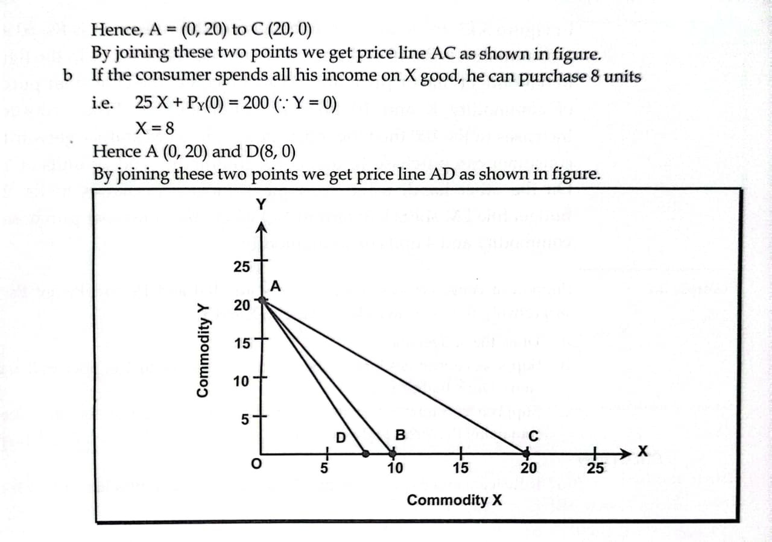

Slide 13
Shift in Budget Line
Shift in budget line is the process of change in position of budget line on the both axes.
Other things remaining the same, when income of the consume changes budget line shift, if income increases it shift right and vice-versa

Slide 14
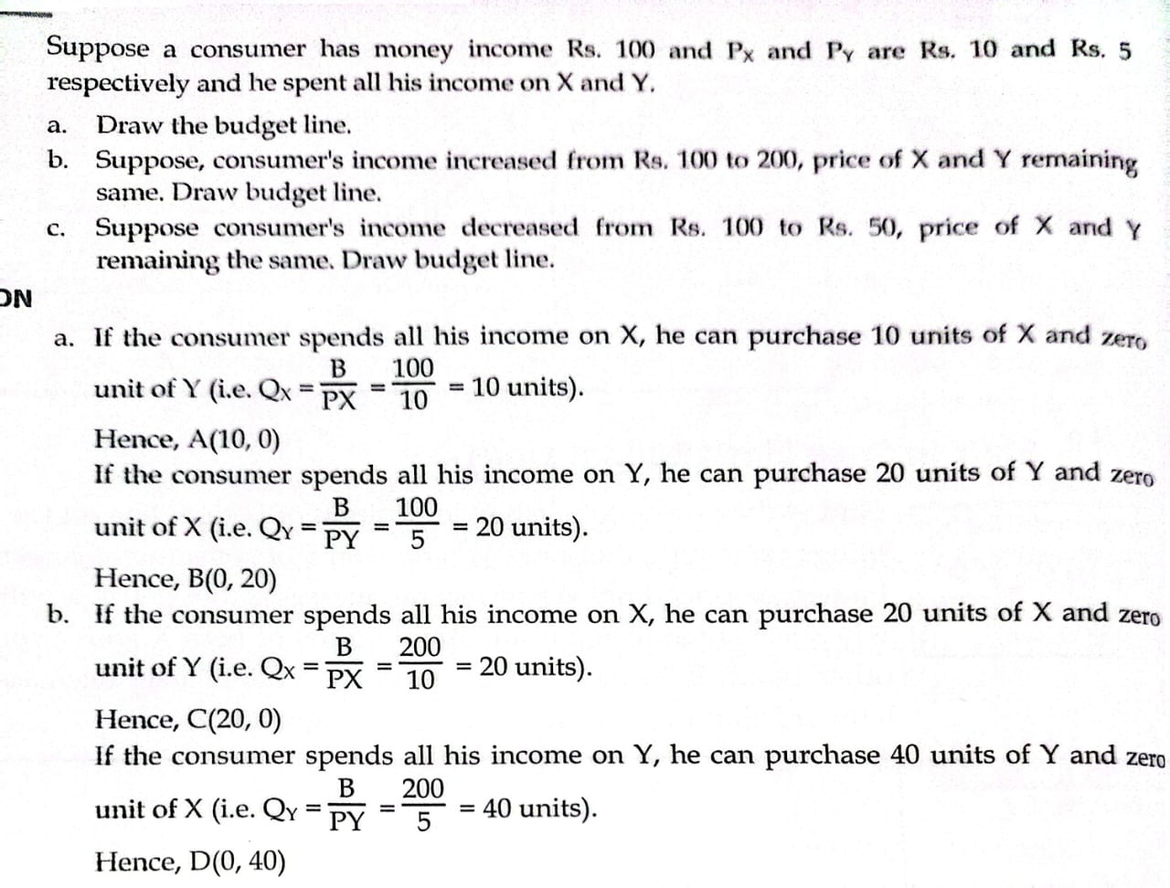
Example

Slide 15
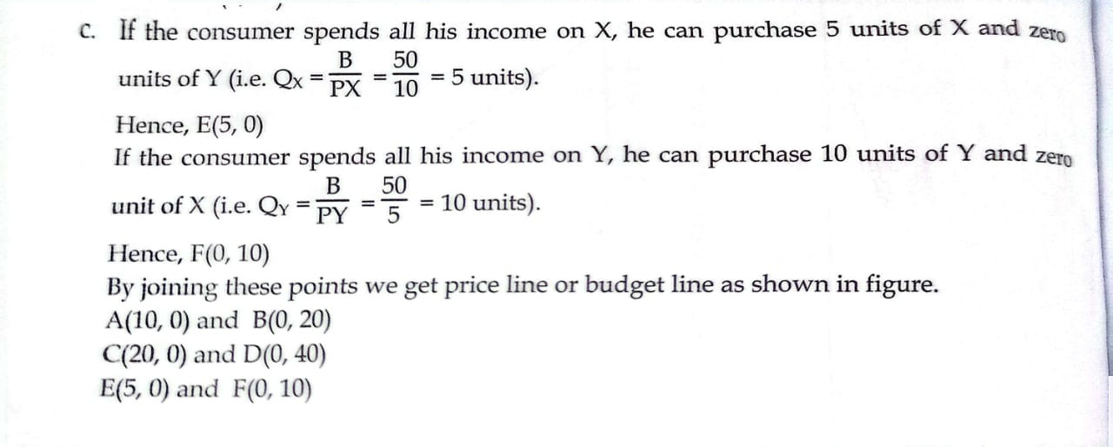

Slide 16
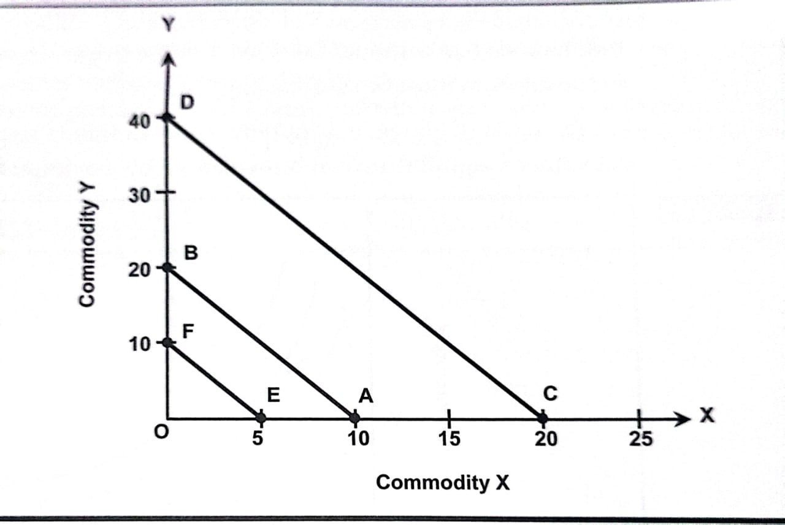

Slide 17
Conclusion
The budget line represents the income and price constraints faced by a consumer. It shows all possible combinations of goods that can be purchased with a given income at given prices. The concept of the budget line is important in applied economics as it helps in understanding consumer choice, demand behavior, and the effects of changes in income and prices on consumption decisions.

Slide 18




Slide 19


